Slide 1

P272 - Detecting Real vs Fake News Using Machine Learning
Team 2
Team Members:
Rajvi Dadhaniya
Deepesh Kumar Verma
Avani Makwana
Evangeline Angel
Aparna P
Sankalp Khare
Jyotirekha Das
Date: 03-Aug-2023

Slide 2
Overview of the Dataset
This dataset consists of about 44898 articles consisting of fake as well as real news. Our aim is to train our model to predict whether a given piece of news is authentic or fake.
1
Size
2
Real vs Fake
3
EDA
The dataset comprises of roughly 44898 articles
The dataset is divided into two separate datasets, one containing real news and the other containing fake news.
Exploratory Data Analysis is used to identify patterns and trends within the datasets.
# add column
true['target'] = 1
fake['target'] = 0

Slide 3
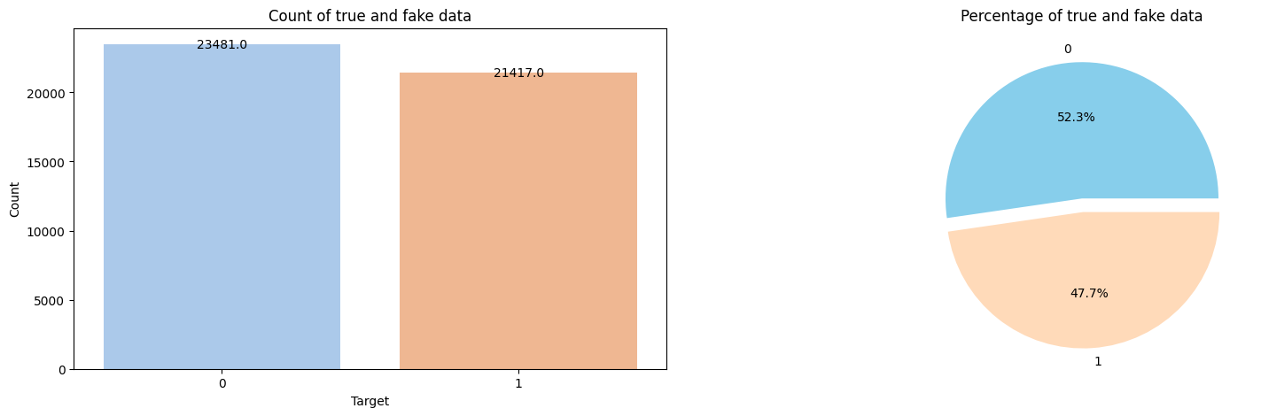
Count of Fake and True/Real Data

Slide 4
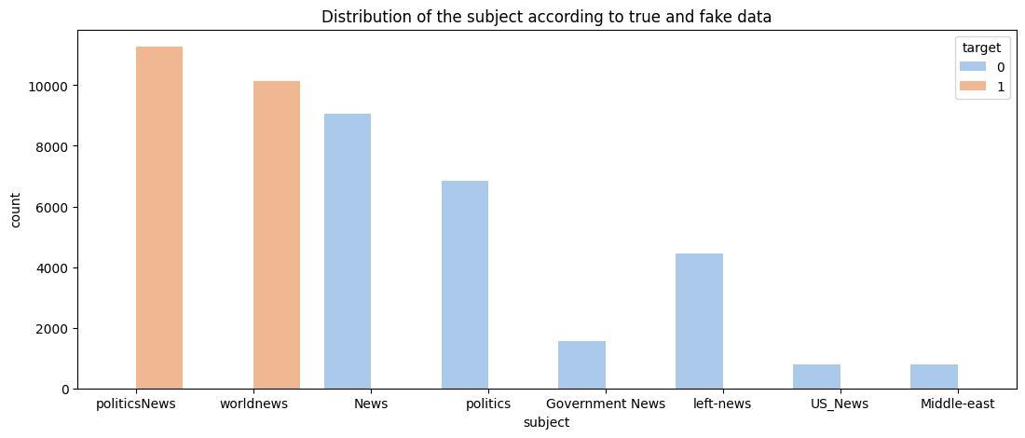

Slide 5
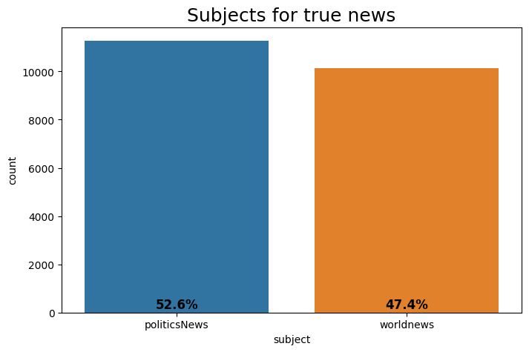
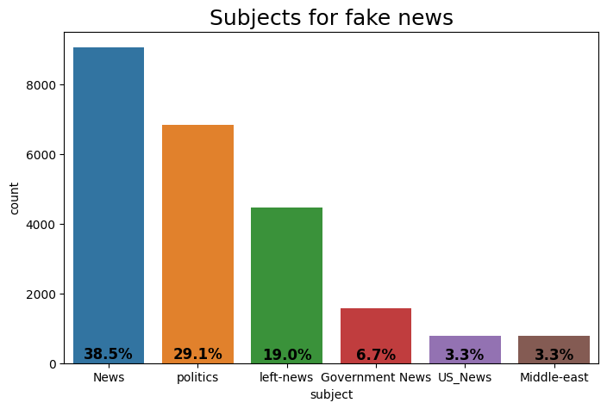

Slide 6
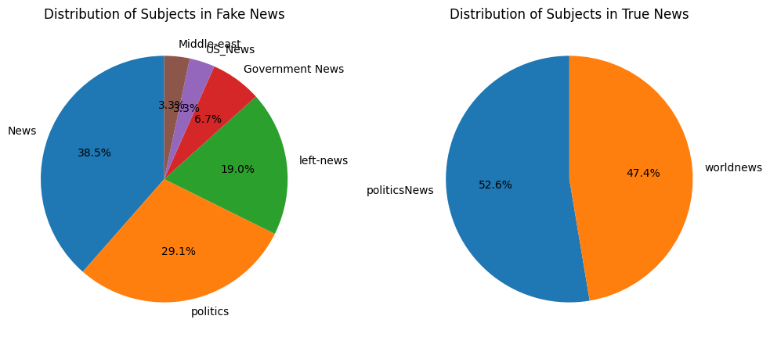

Slide 7
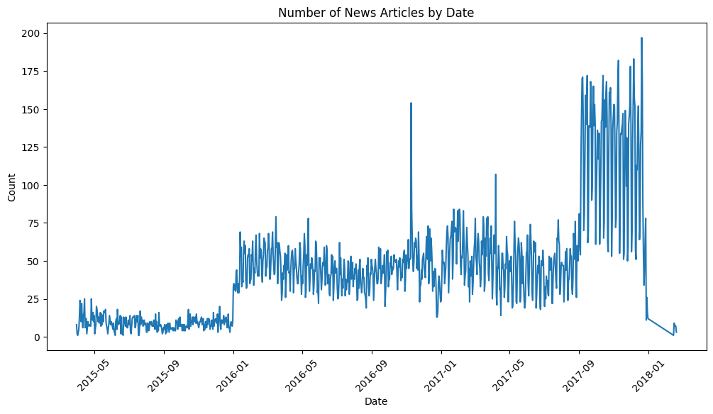

Slide 8
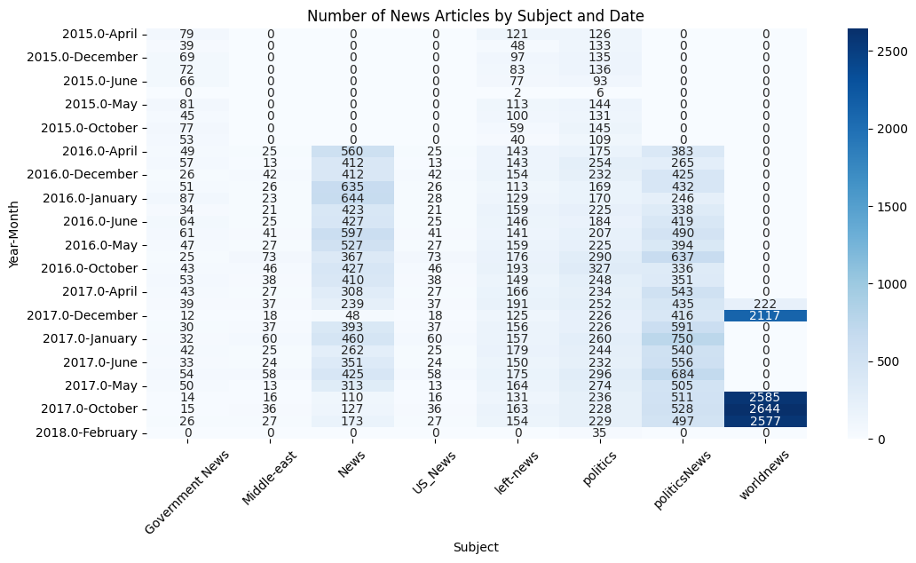

Slide 9
Preprocess the Text Data:
This section deals with preparing the data for analysis by performing various cleaning tasks on the text data.
Removal of HTML Contents
HTML tags, if present, are removed from the text data.
Removal of Punctuation Marks and Special Characters
Punctuation marks and special characters are removed from the text data.
Removal of Stopwords
Commonly occurring words with little or no significance (stopwords) are removed from the text data.
Lemmatization
Words are reduced to their base or root form using lemmatization techniques.
Perform it for all the examples
The cleaning tasks are applied to all examples in the dataset. (for complete dataset)

Slide 10
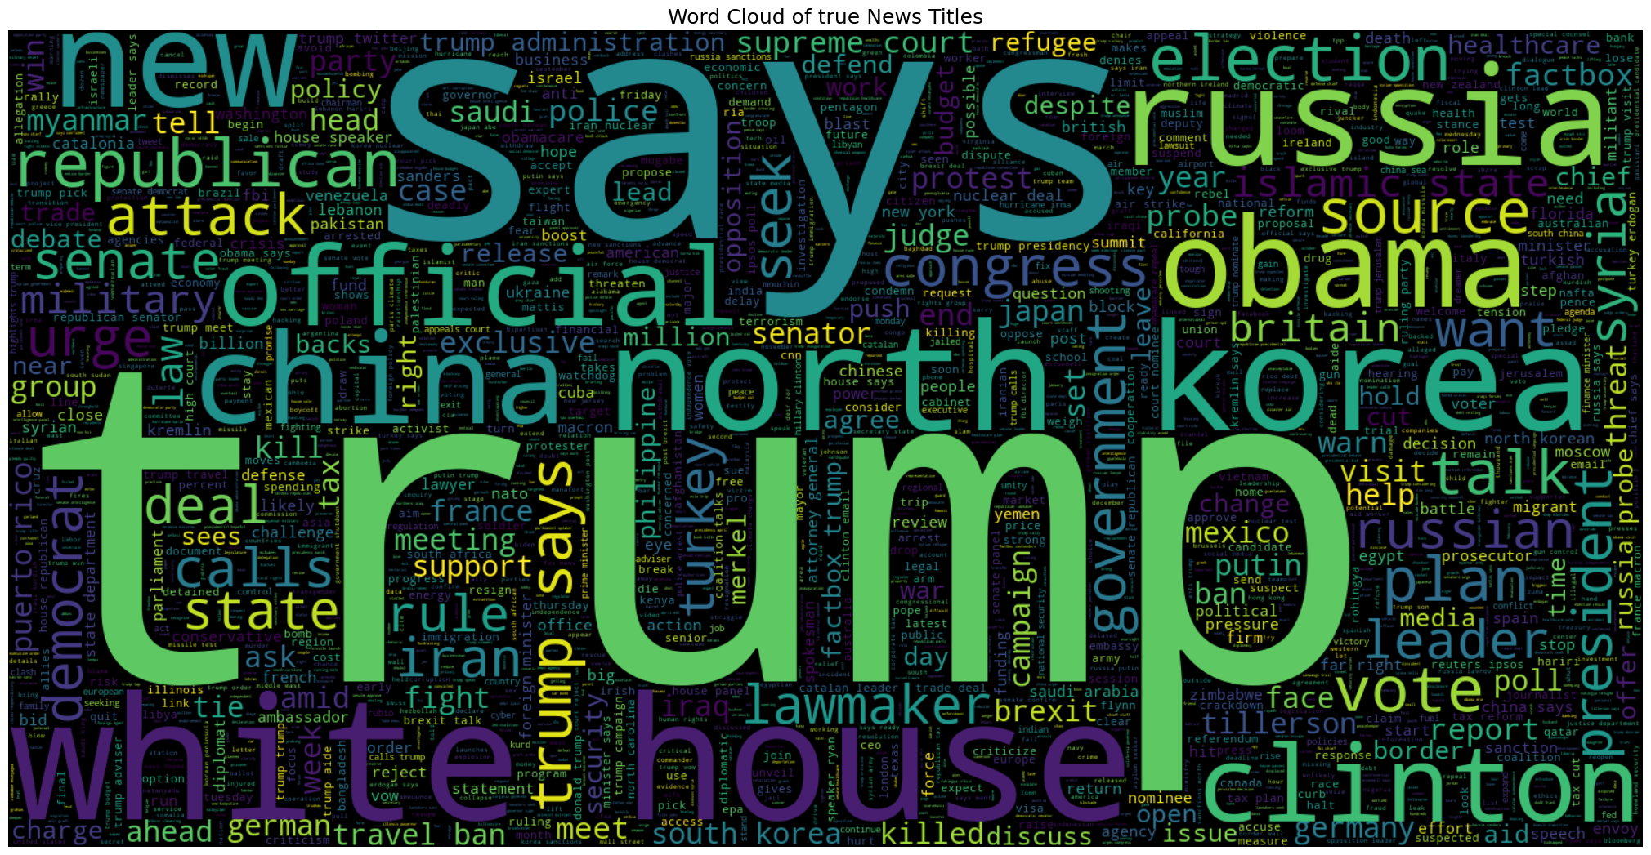
WordCloud for Real News

Slide 11
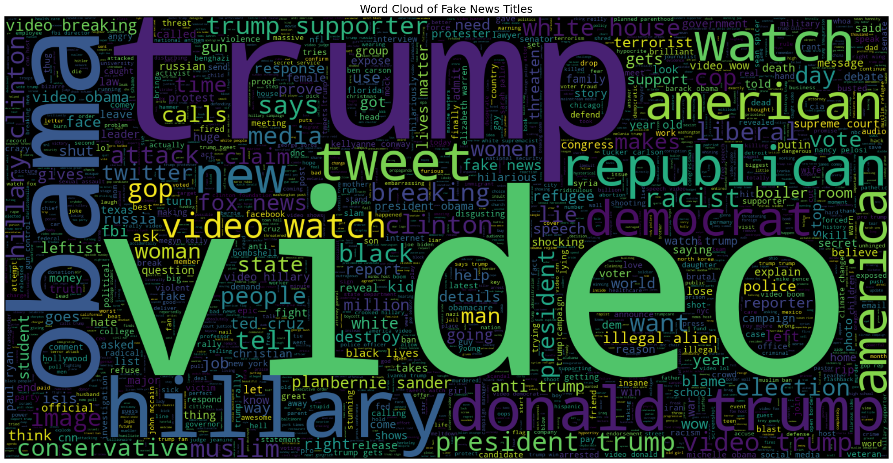
WordCloud for Fake News

Slide 12
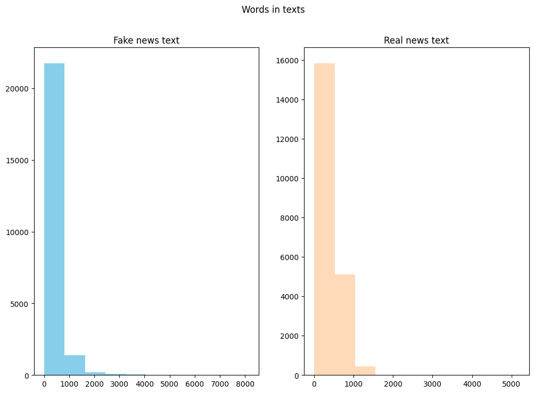

Slide 13
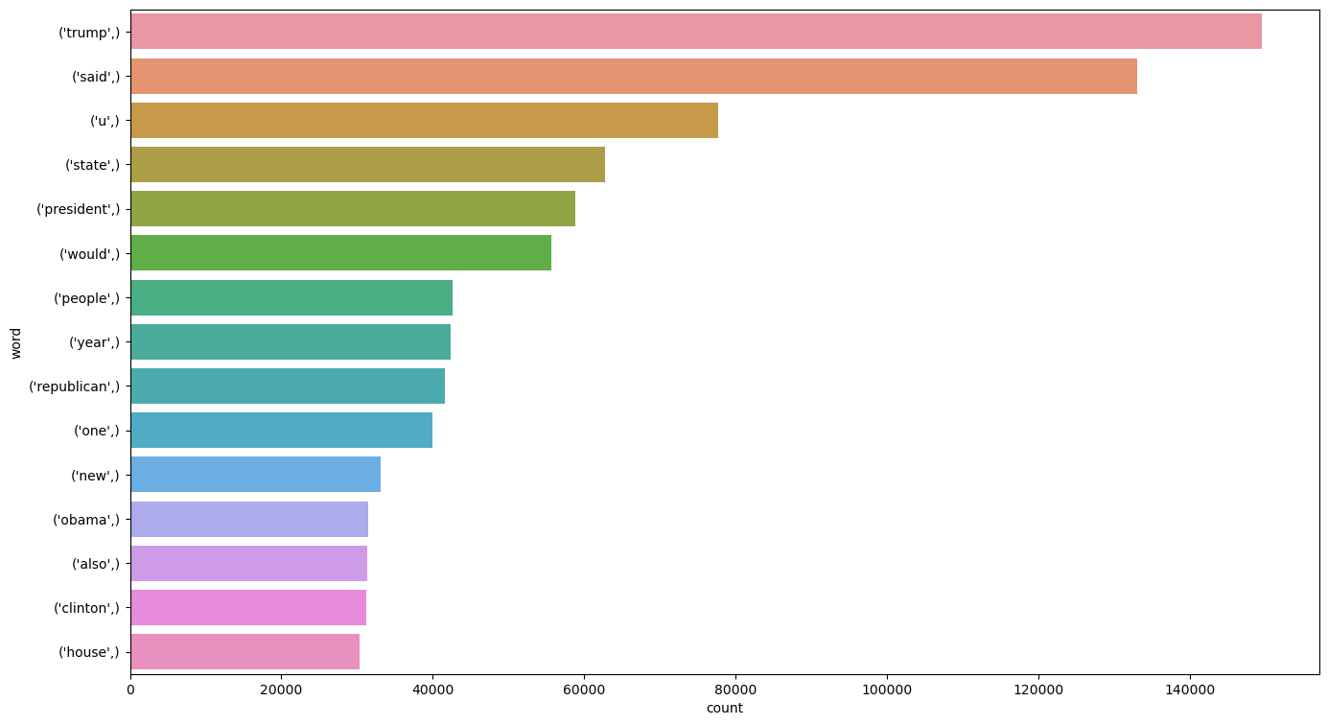
N-Gram Analysis: 1. Unigram [ Analysis is done on single words (individual tokens) in the text data.]

Slide 14
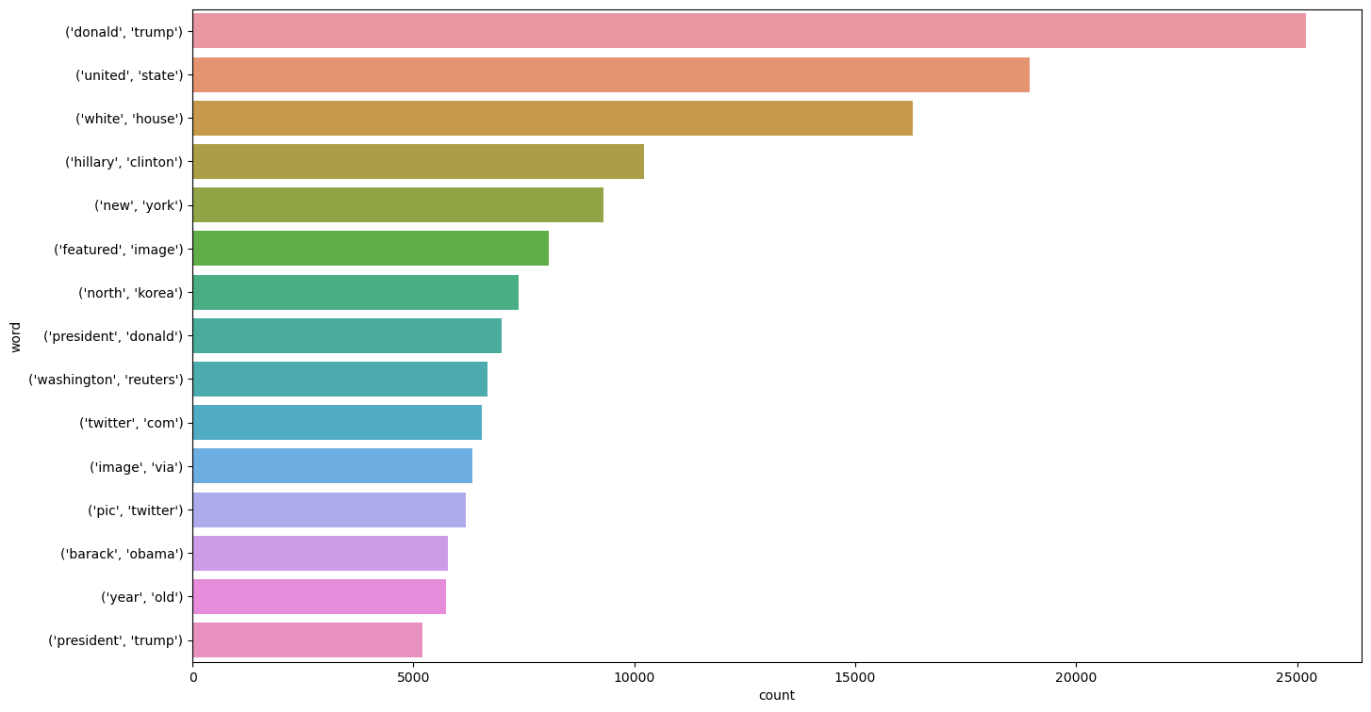
2. Bigram [ Analysis is done on pairs of consecutive words in the text data.]

Slide 15
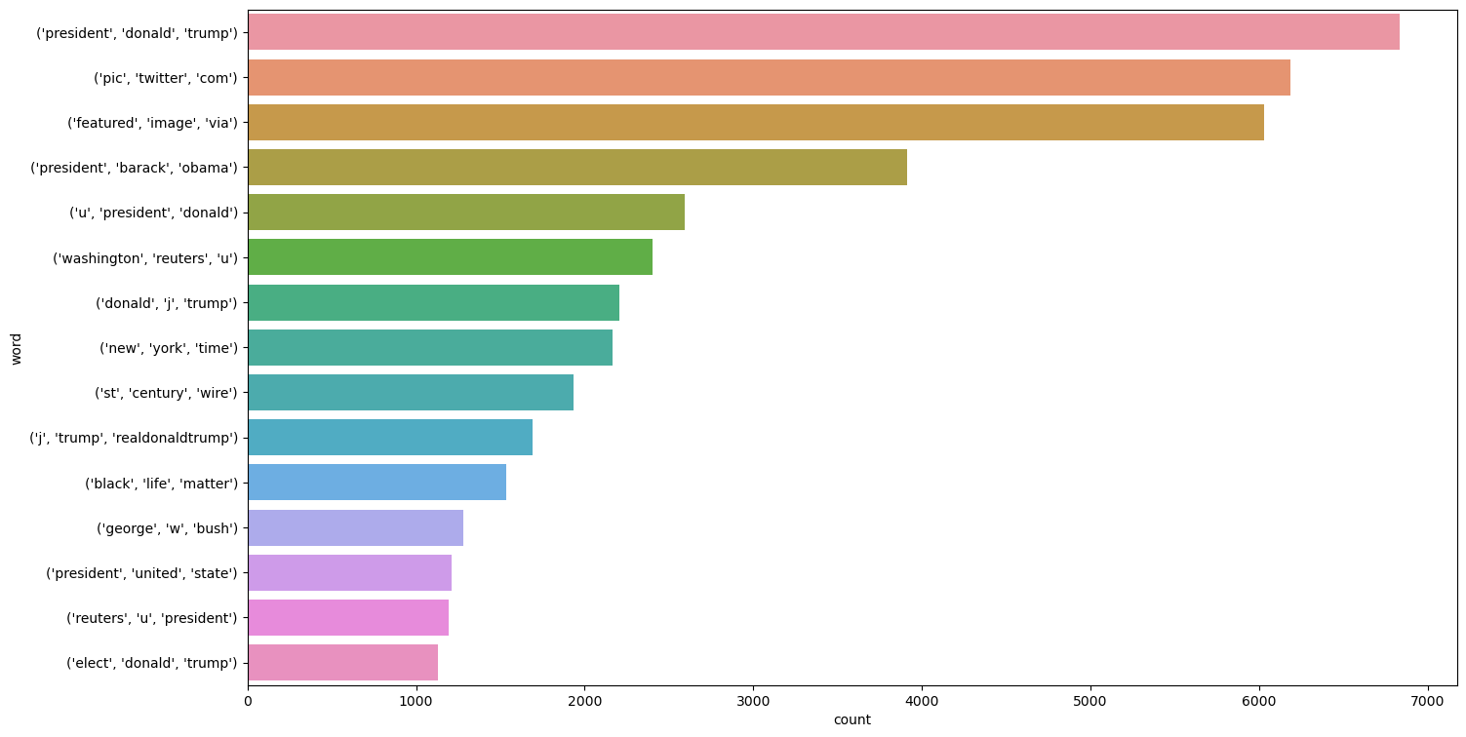
3. Trigram [· Analysis is done on triplets of consecutive words in the text data. ]

Slide 16
Key Findings from EDA
Right-Leaning Real News
Conspiracy Theories
Accounts for the majority of real news articles.
Are a prevalent trend in fake news.
Shared Words
Frequent Word Pairs
Words such as ‘people’ and 'Trump' appear frequently in both real and fake news.
The most common word pairs for real news are 'New York' and 'White House', while fake news has 'Hillary Clinton' and 'President Trump'.

Slide 17
Model Building

Slide 18
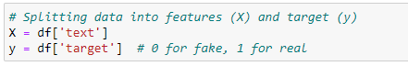

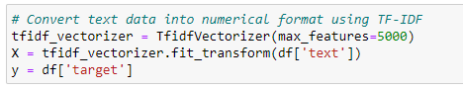
Train-Test Split
TF-IDF Vectorizer

Slide 19
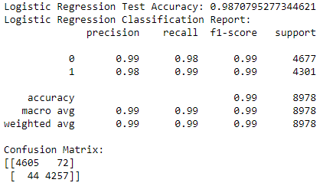
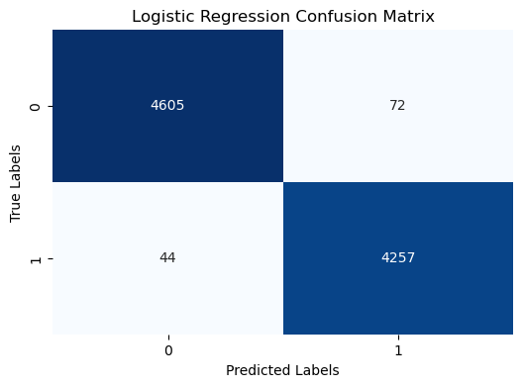
1. Logistic Regression

Slide 20
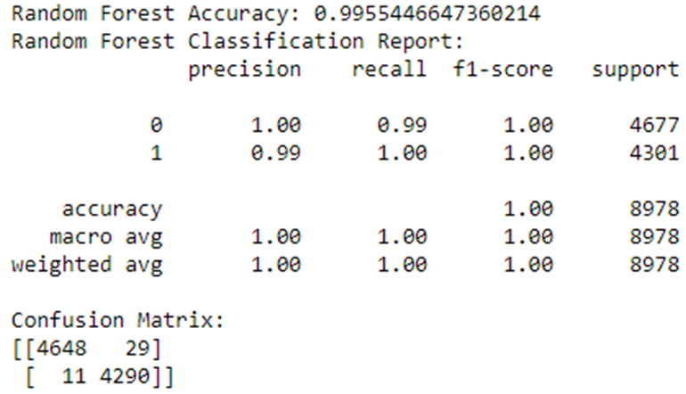

2. Random Forest

Slide 21
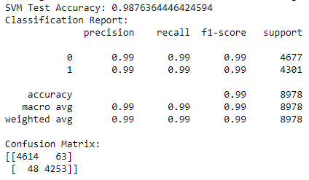
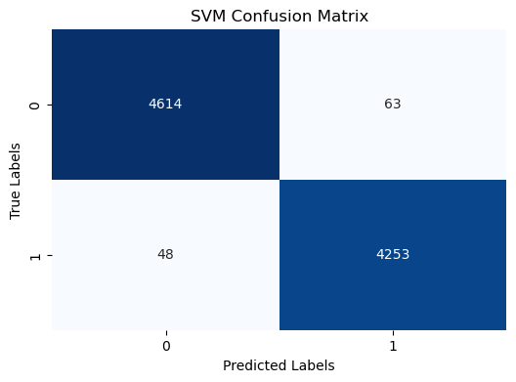
3. Support Vector Machine

Slide 22
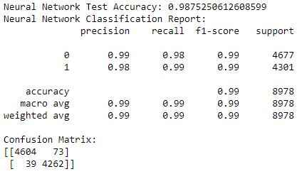

4. Neural Network

Slide 23
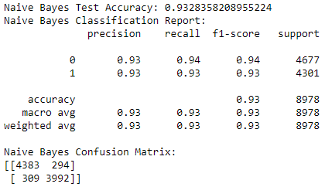
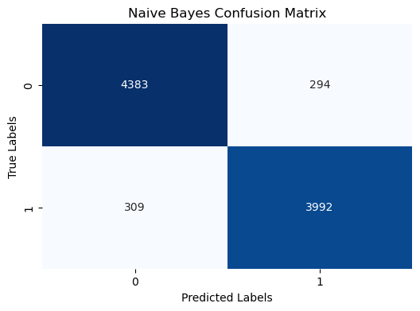
5. Naïve Bayes

Slide 24
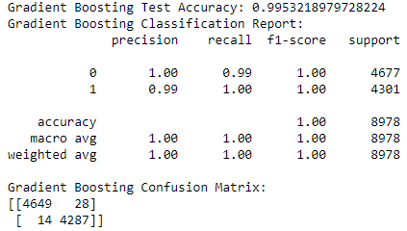

6. Gradient Boosting

Slide 25
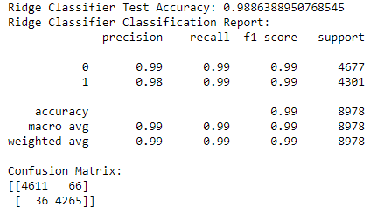

7. Ridge Classifier

Slide 26
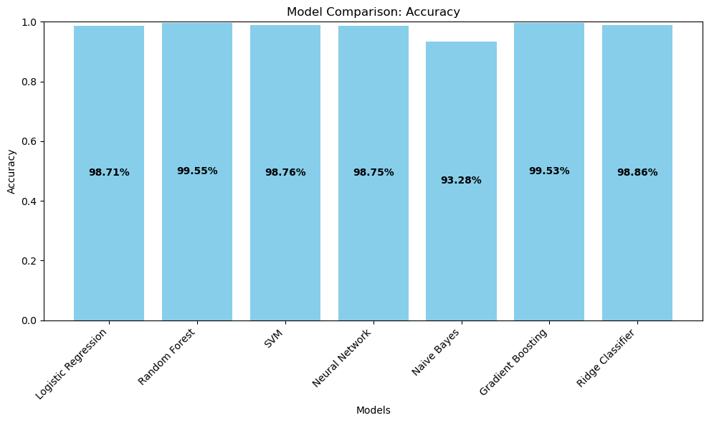

Slide 27
Deployment

Slide 28


Slide 29
Challenges Faced:
After performing Hyperparameter tuning, the computation timing increased.
When doing the deployment, we faced an issue with processing input text into the model, as it showed an error when trying to convert a string to a float.
Overcoming these Challenges
To overcome the aforementioned challenges, we opted to utilize the cloud-based Google Colab IDE, thus preventing the consumption of space on my personal computer.
Additionally, we generated a fresh pickle file for the tf_idf_vectorizer and seamlessly integrated it during deployment. By employing this approach, the text data was initially converted to a float format before being passed to the model, effectively addressing the conversion issue.

